Slide 1
Flowcharts
What is a flowchart? | A diagram to show the flow of data and action
Why are they used in algorithm design? | They are simple to create and understand; can show all of the algorithm
Shape/symbol | Identify the shape/symbol AND describe its purpose | What is/are the pseudocode equivalent?
 | Oval - Start/End Shows the start OR the end of an algorithm | Start end
 | Parallelogram – input / output Takes an input or output | Input output
 | Rectangle – process Processes a command | Do
 | Diamond – decision Answers a condition with yes or no | If Elif
 | Arrow – connector Shows the flow of data | BLANK

Slide 2
Flowchart Algorithms
PRINT “Enter a number”
INPUT num1
Total = num1 * 10
PRINT Total
The algorithm above has been designed using pseudocode. Create the flowchart version of this algorithm below using the correct shapes/symbols
Start/Begin
Input Num 1
Total = num1 * 10
PRINT Total
End

Slide 3
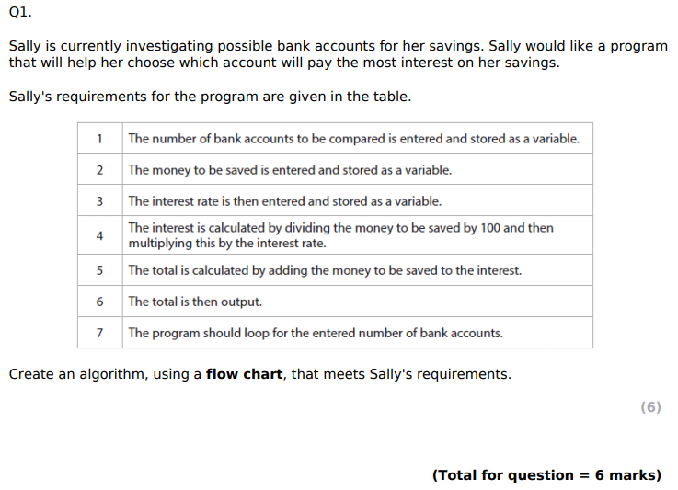
Bronze 1
Exam Questions

Slide 4
Bronze 1
Exam Questions
Start/Begin
NumBankAcc = input number of bank accounts
Savings = input amount of money saved
InterestRate = input interest rate
Interest = savings / 100 * InterestRate
Total = savings + Interest
Print Total
NumBankAcc = NumBankAcc - 1
N
NumBankAcc = 0?
Y
End

Slide 5
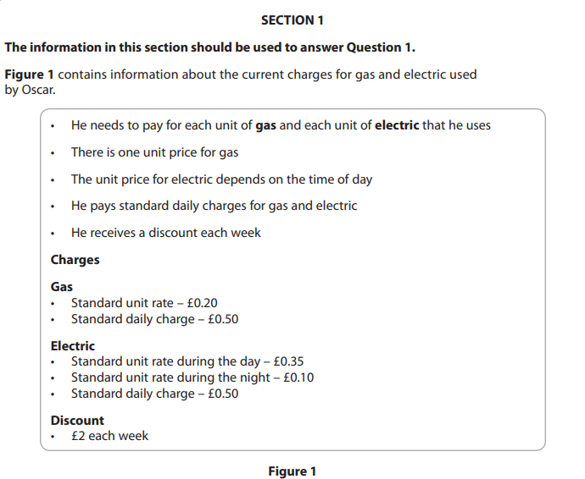
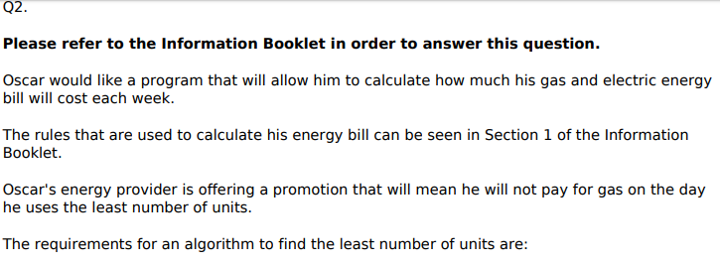
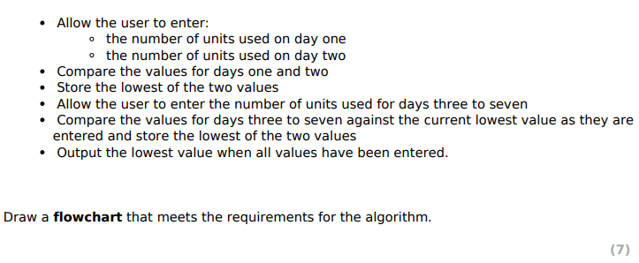
Silver 1
Exam Questions

Slide 6
Silver 1
Exam Questions
Create the flowchart in the space below [7]

Slide 7
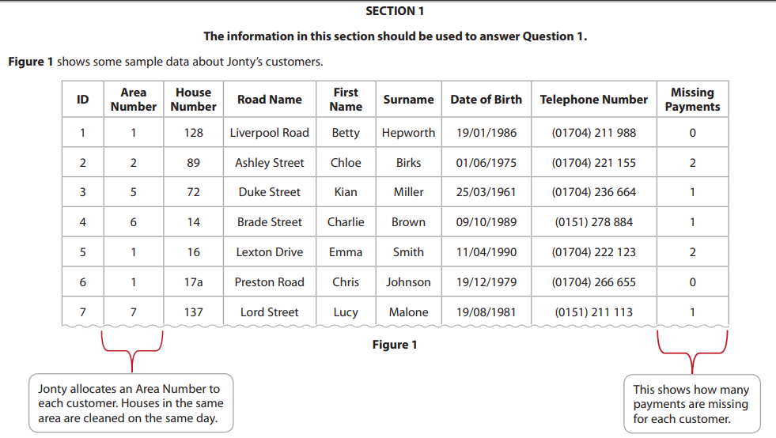
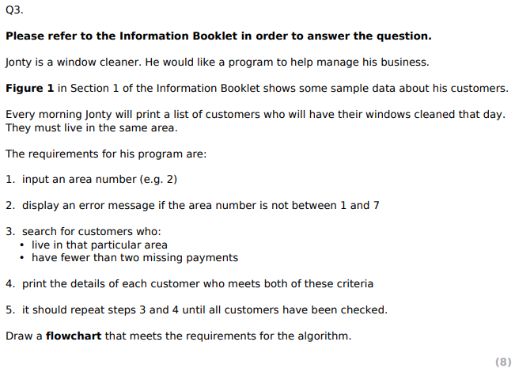
Gold 1
Exam Questions

Slide 8
Gold 1
Exam Questions
Create the flowchart in the space below [8]

